Slide 1
BIOE598 Case Study 2: Find minimal set of amino acid required for a bacterium
Reporter: Zong Fan
Email: zongfan2@illinois.edu

Slide 2
1. Objective
Use 96 experiments to predict the smallest combination of amino acid for bacteria to grow.
Experiments is split into 2 rounds.

Slide 3
2. Round 1: Method
Use 32 runs in 2-level Resolution III Fractional Factorial (FF) Design
Map Amino acid to following symbols:
amino acid | aa01 | aa02 | aa03 | aa04 | aa05 | aa06 | aa07 | aa08 | aa09 | aa10 | aa11 | aa12 | aa13 | aa14 | aa15 | aa16 | aa17 | aa18 | aa19 | aa20
symbol | A | B | C | D | E | F | G | H | J | K | L | M | N | O | P | Q | R | S | T | U
So the Defineing relation for this design:
I = ABF = ACG = BCH = ADJ = BDK = BCDL = ABCDM = AEN = BEO = BCEP = ABCEQ = BDER = ABDES = CDET = ACDEU

Slide 4
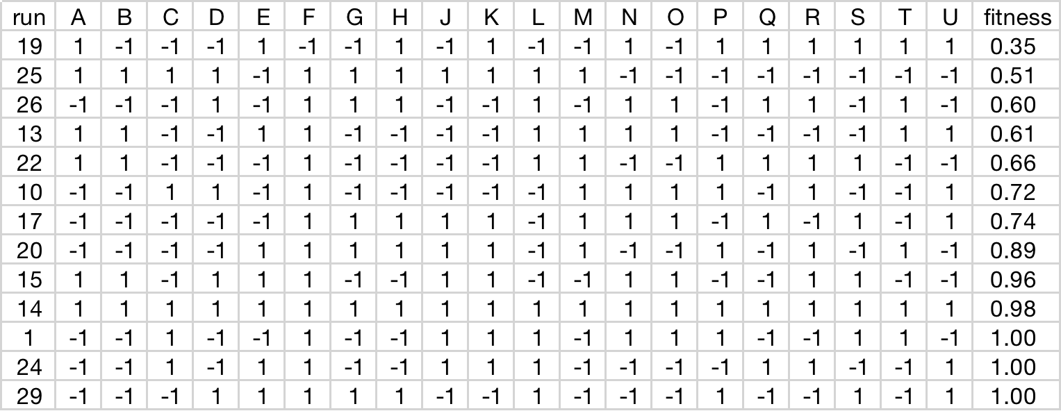
3. Round 1: Results
Set fitness threshold = 0.3, then runs with positive fitness are:

Slide 5
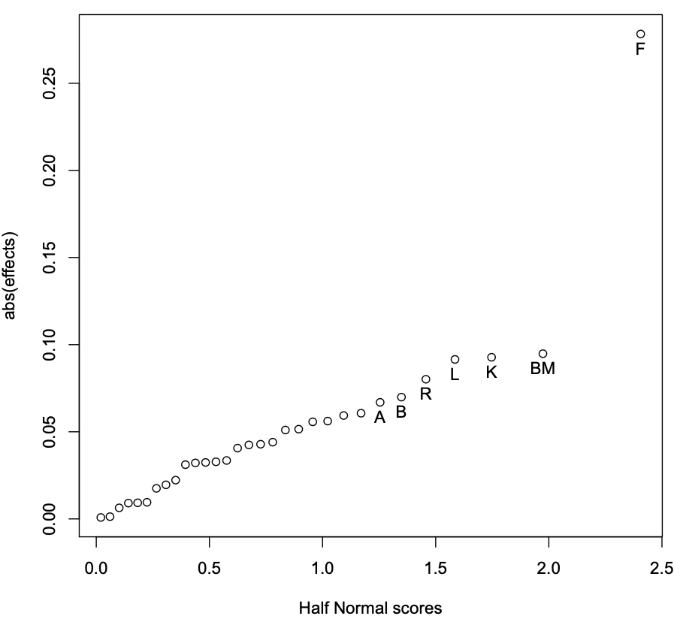
3.1 Significant effects from Half-normal plot
Since we only have 32 runs for 20 main effects, there is no DoF left for confidence intervals. We use Half-normal plot instead.
Only F has relatively large coefficient. For fitness threshold = 0.3, F = 1 in 8/13 runs; if the threshold is set as 0.5, F = 1 in 8/8 runs. It indicates that F may be required for high fitness.
For the rest potential significant factors, A, B, R, L, K are main effects. So we need mirror image design to clear these main effects in the second run.
BM is the TWI term.
Therefore, A, B, F, K, L, M, R are the selected factors to investigate in the second round.

Slide 6
4. Round 2: Method
Use first 32 runs as mirror image of the first round with all factor flipped.
Use 32 runs in Resolution V half-fractional design for factors A, B, K, L, M, R. Set F=1 and the rest factors as -1
Design II's defining relation is:
I=ABKLMR=BKLMR=AKLMR=ABLMR=ABKMR=ABKLR=ABKLM

Slide 7
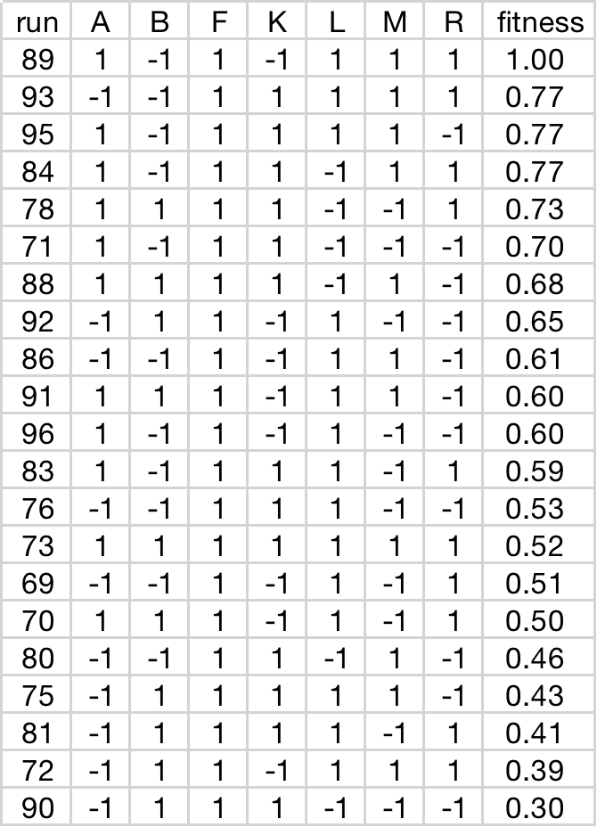
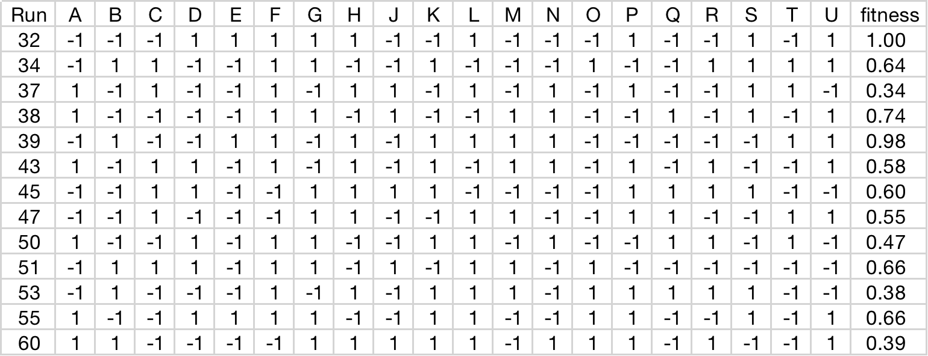
5. Round 2: Results
Postive results of resolution V design II
Postive results of mirror design I

Slide 8
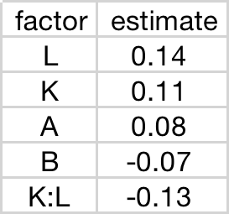
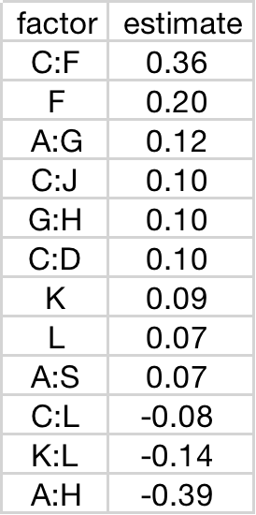
5.1 Significant Effects
1. Combine data of round 1 and both round 2 I, II
2. Use only data of round 2 II
Significant Factors and effect sizes
Significant Factors and effect sizes
Note: F is set to 1 in this design
So the mirrored design confirms that F, K, L are significant main effects.
L, K are positive while their interaction are negative. Perhaps use either of them is enough for good fitness.
(A,B are near-significant)

Slide 9
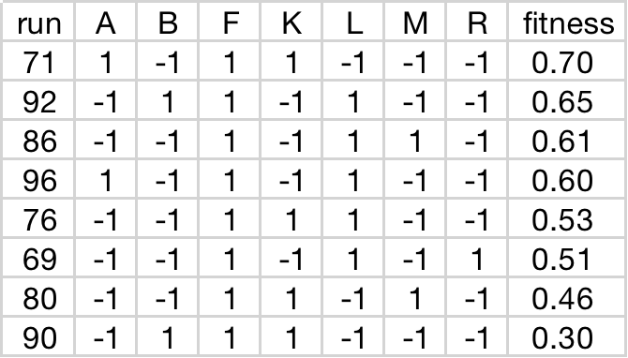
5.2 Minimum set of factors
Analyze the result of round 2 II design. We find the minimum number of required factors are 3.
The combination could be:
AFK, BFL, FLM, AFL, FKL, FLR, FKM, BFK

Slide 10
6. Conclusion
The significant main effects are mainly F, K, L, A, B.
Factor F has the largest positive conbribution, while interaction of K and L may have negative impact.
The minimum set of animo acid to guarantee bacteria fitness could be AFK, BFL, FLM, AFL, FKL, FLR, FKM, BFK.
We choose the largest 4 (AFK, BFL, FLM, AFL) as the final evaluation run.

Slide 11
7. Appendix: Code
# change column names
names(data)[1:20] <- names(des1)
model <- lm( fitness ~ (.)^2, data=data)
cfs <- na.omit(coef(model))[-1:-1]
labels <- names(cfs)
daewr::halfnorm(cfs, labels, alpha=0.25, refline=FALSE)
# select parameters with exhaustive
modpbr <- regsubsets(fitness~(.)^2, data=data, method="exhaustive", nvmax=4, nbest=4, really.big=TRUE)
rs <- summary(modpbr)
plot(c(rep(1:5,each=4)), rs$adjr2)
plot(modpbr, scale="r2")
# second round
# select A, B,M,L,K,R, set F=1, and rest values as -1
# resolution V
des2 <- FrF2(32, 6, res.min=5)
library("FrF2")
library("daewr")
library("leaps")
# first round
# 32 run with 3 resoulution
setwd("/Users/zongfan/Downloads")
des1 <- FrF2(nruns=32, nfactors=20, res.min=3)
# load result of first resoulution
data <- read.csv("casestudy2_result_round1.csv", skip=1)
data <- data[,-1:-1]
# high fitness threshold
thres<-0.5
data_p <- na.omit(data[data$fitness>thres,])
data_n <- na.omit(data[data$fitness<thres,])

Slide 12
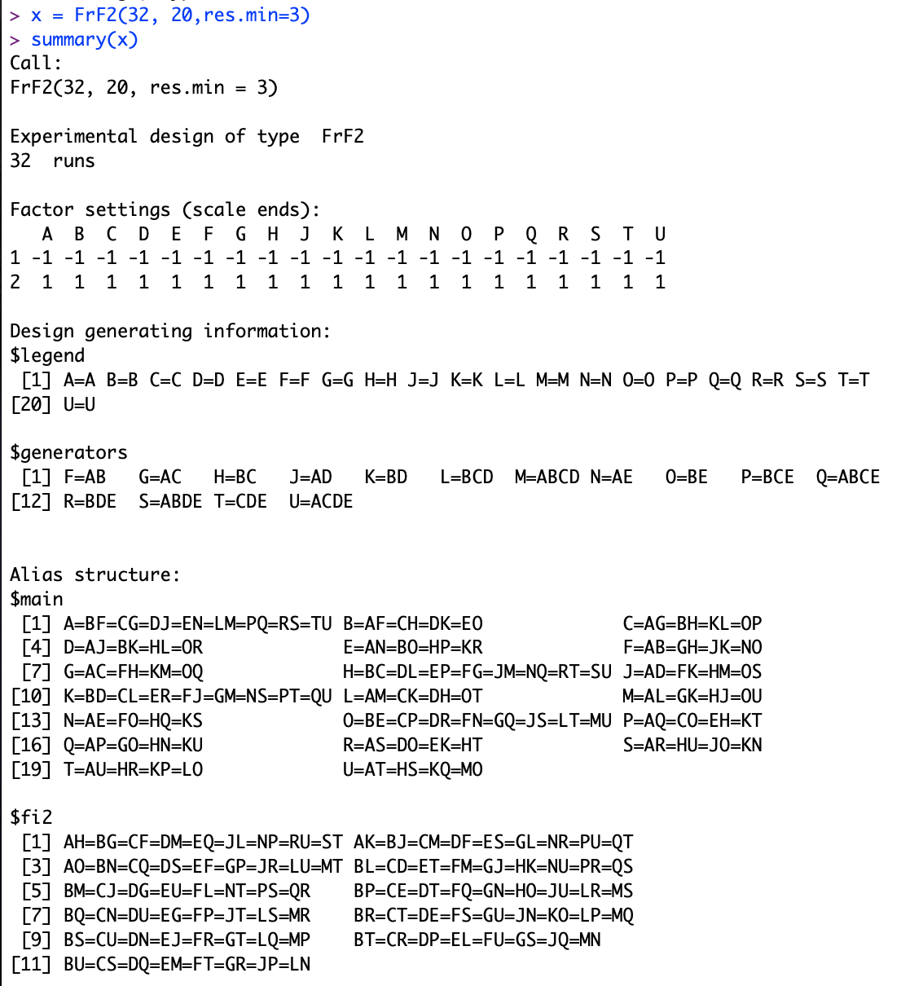
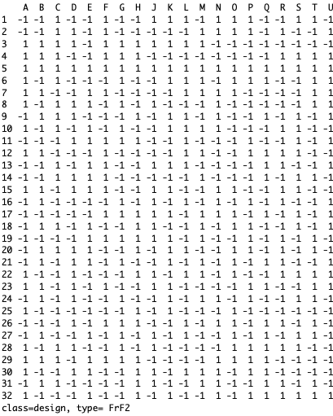
Round 1 Design

Slide 13
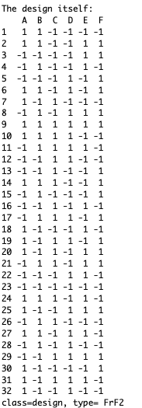
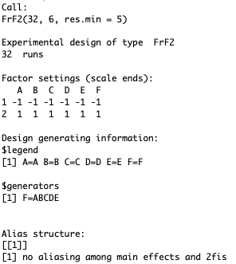
Round 2 Design

Slide 14
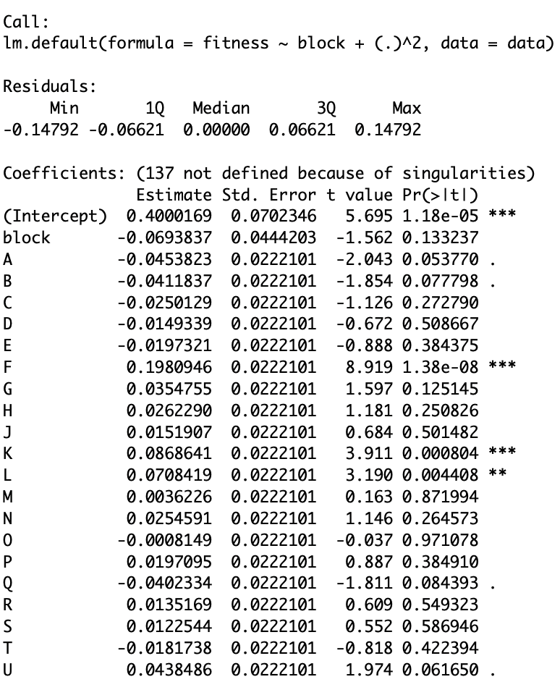
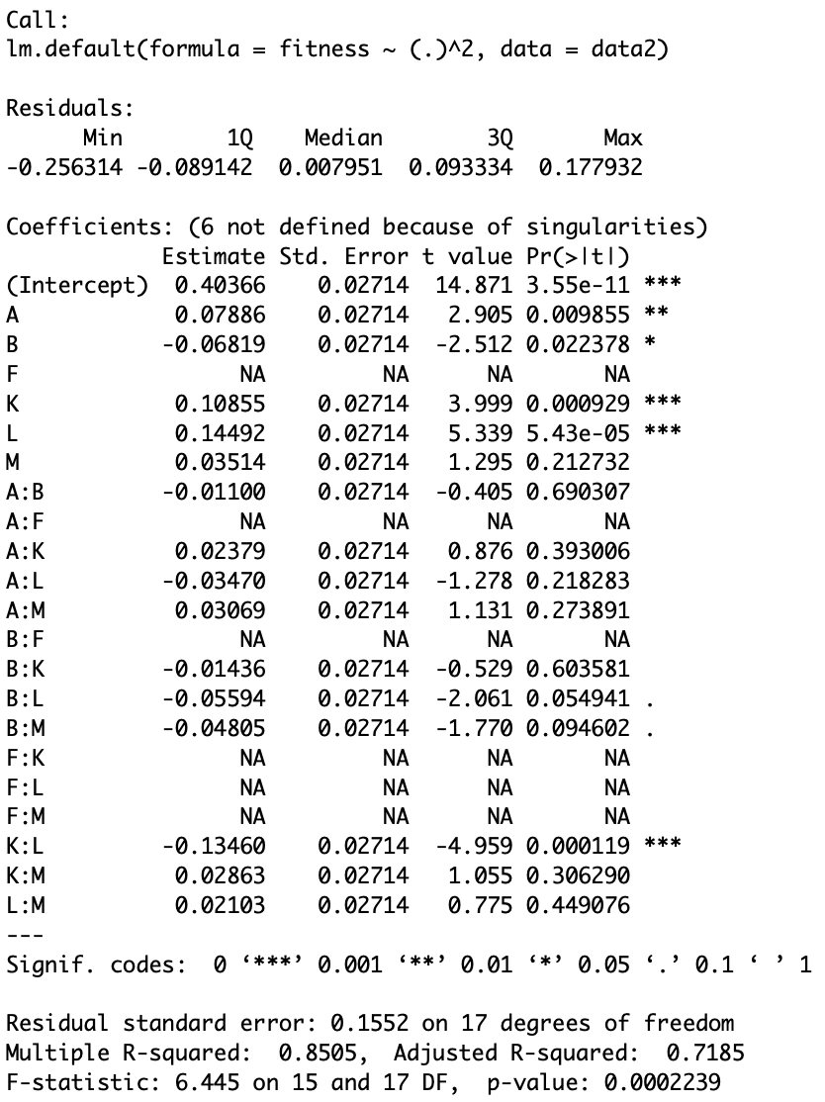
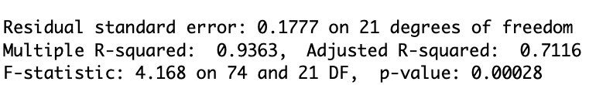
Round 2 Model fitting results
Fitting result of main effects combining round1 and round2 data with blocking factor
Fitting result of main effects with only round2 II design data

